Slide 1
CRM Analysis

Slide 2
Goal
Customer Relationship Management (CRM) analysis to Examine and interpret data related to interactions between a business and its customers to evaluate customer behavior, preferences, and feedback to gain valuable insights into their needs and expectations.

Slide 3
Understanding the DATA
Total No of records - 541909
No of Columns – 8 (Invoice No, Stock Code, Description, Quantity, Invoice Date, Unit Price, Customer ID, Country)
No of Null values : Description – 1454 and Customer IDs – 13508
Unique count Before and After treating Null values and Outliers -
Total Items Sold – 2389218
Total Revenue - 4075265.144$
Most Transacted item - WHITE HANGING HEART T-LIGHT HOLDER
Invoices | 21269
Products | 3676
Customers | 4331
Countries | 37
Invoices | 18650
Products | 3396
Customers | 4184
Countries | 37

Slide 4
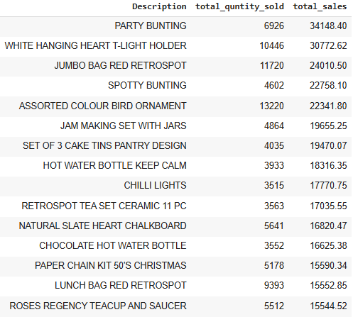
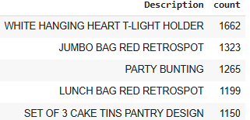
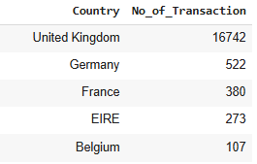
Insights
Top Products by sale and quantity sold
Top 5 products by no of transaction
AOV
218.5$
Days between Purchases
3.3 Days
Top 5 countries by no of transaction
Busiest Day
Thursday
Busiest Week
Second Week

Slide 5
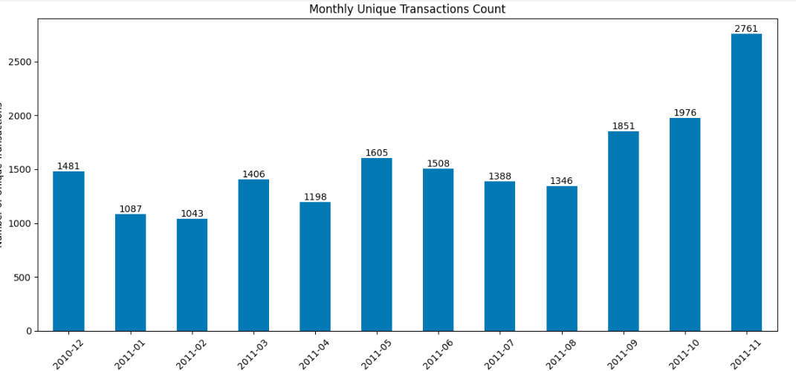
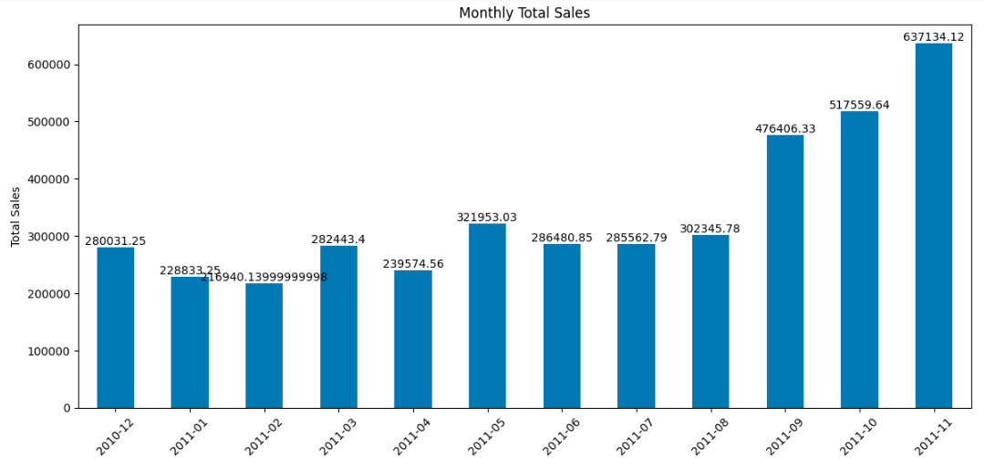
Trends
Month-Year | Description | Total Quantity
2010-12 | HAND WARMER BABUSHKA DESIGN | 1169
2011-01 | PACK OF 12 HEARTS DESIGN TISSUES | 1044
2011-02 | PACK OF 72 RETROSPOT CAKE CASES | 1144
2011-03 | PACK OF 72 RETROSPOT CAKE CASES | 1511
2011-04 | PACK OF 72 RETROSPOT CAKE CASES | 1564
2011-05 | PACK OF 72 RETROSPOT CAKE CASES | 1506
2011-06 | SET OF 60 PANTRY DESIGN CAKE CASES | 1257
2011-07 | SET OF 60 PANTRY DESIGN CAKE CASES | 1458
2011-08 | JUMBO BAG RED RETROSPOT | 1297
2011-09 | JUMBO BAG VINTAGE DOILY | 1520
2011-10 | WOODEN STAR CHRISTMAS SCANDINAVIAN | 1827
2011-11 | RABBIT NIGHT LIGHT | 3418

Slide 6
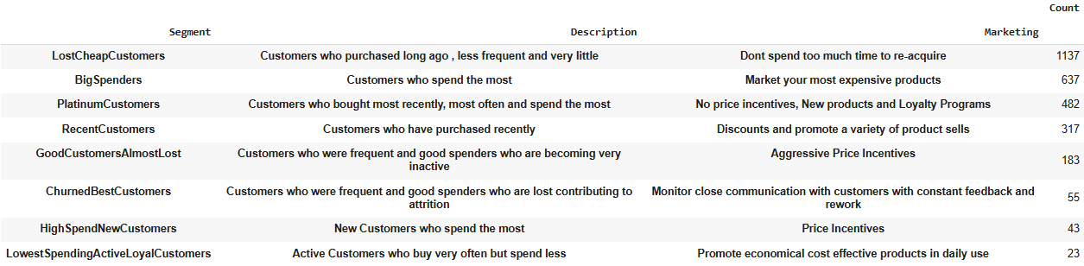
RMF Analysis
Segmentation by RFM scores
Link to the RFM Table with Segment, Description and Marketing Strategy for each user - RFM_table

Slide 7
Recommendations
Increase inventory and targeted promotions for top products like Party Bunting and White Hanging Heart T-Light Holder.
Consider bundling products like Party Bunting with related items for higher value per transaction
Explore strategies to increase sales in countries like Germany and France, such as localized marketing campaigns or optimized shipping options.
Schedule flash sales or targeted discounts on Thursdays to capitalize on the busiest day.
Plan restocking and logistics for the second week of the month to ensure availability during peak demand.
Recommend products that are most bought together and Upsell accessories or complementary items during checkout.
Since November experiences the highest sales and transactions, plan for this peak by :- Stocking up on high-demand products like Rabbit Night Light and Christmas-themed items. Launching targeted holiday promotions or bundles to capitalize on customer interest.
Focus on promoting top-selling products like Pack of 72 Retrospot Cake Cases, which have shown consistent demand over time.
Perform a deeper analysis of why specific products like Rabbit Night Light spiked in November. This could provide insights into customer behavior for planning future inventory and marketing campaigns.
Monitor trends monthly to identify emerging popular products or shifts in customer preferences. For example: If a new product gains traction (e.g., Jumbo Bag Vintage Dot in October), consider ramping up production or promotion for that item.
Products like Wooden Star Christmas Scandinavian indicate early interest in festive items as early as October. Start holiday marketing and inventory planning by September to capture early shoppers.

Slide 8
Recommendations Based on RFM ANALYSIS
Lost Cheap Customers | Big Spenders | Platinum Customers | Recent Customers
Use low-cost, automated campaigns. Offer clearance sales and "last chance" deals. | Upsell premium products with personalized offers. Create a VIP loyalty program with exclusive perks. | Prioritize in product launches and loyalty programs. Send thank-you gifts and exclusive deals. | Follow up with personalized recommendations. Offer loyalty points or discounts for next purchases.
Good Customers Almost Lost | Churned Best Customers | High Spend New Customers | Lowest Spending Active Loyal Customers
Launch re-engagement campaigns with aggressive pricing. Send "we miss you" time-sensitive deals. | Run win-back campaigns with surveys and personalized offers. Highlight new features or products they might like. | Welcome with tailored recommendations and post-purchase support. Include in exclusive launches to build loyalty. | Promote economical, value-driven products. Encourage bulk purchases with discounts.

Slide 9
Thank you
Shubham Chauhan

